Slide 1

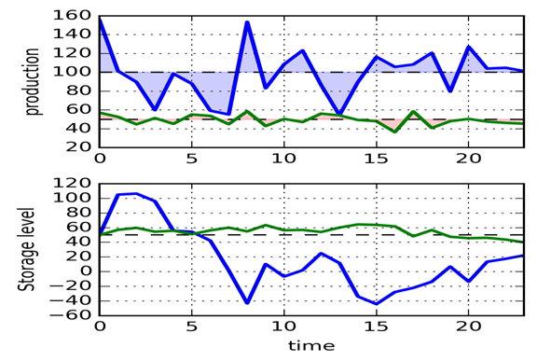

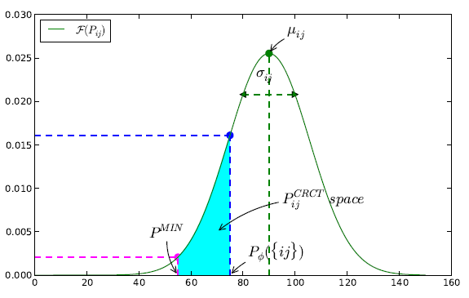
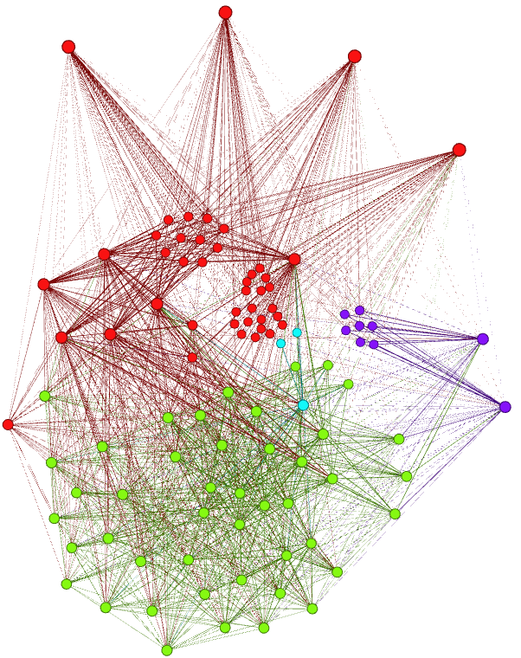
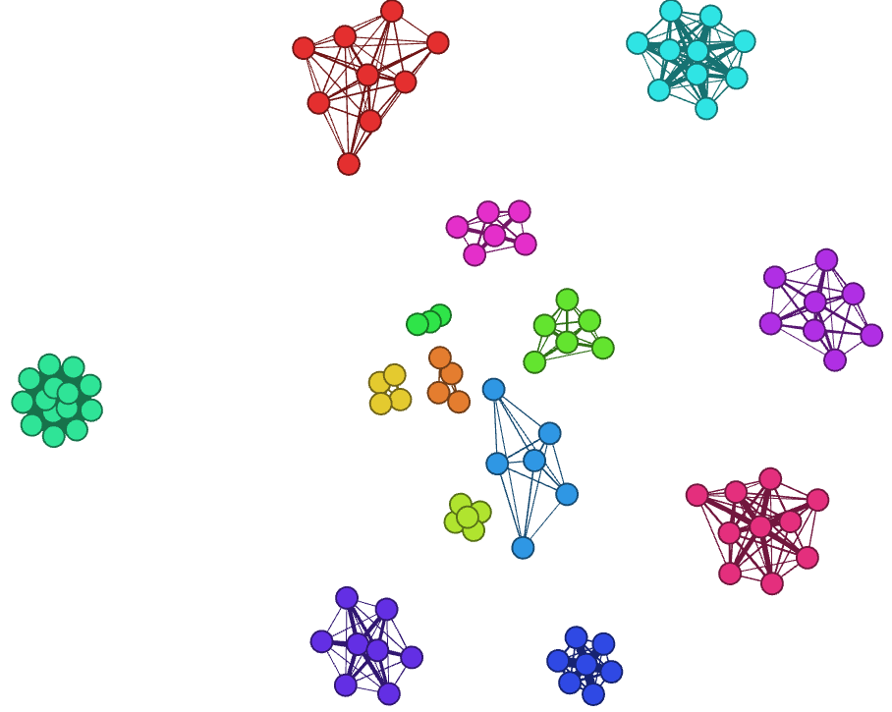


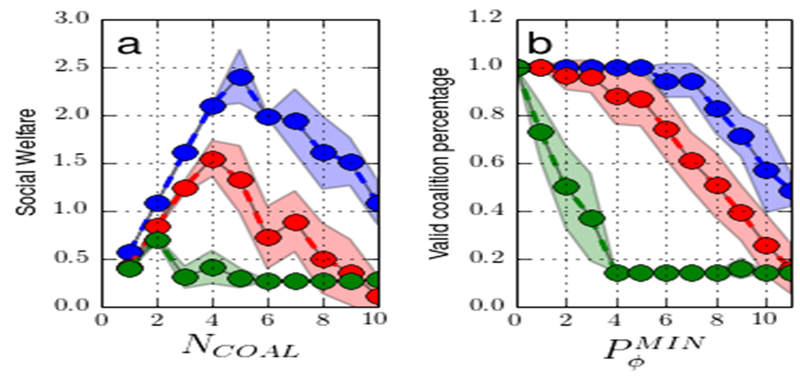
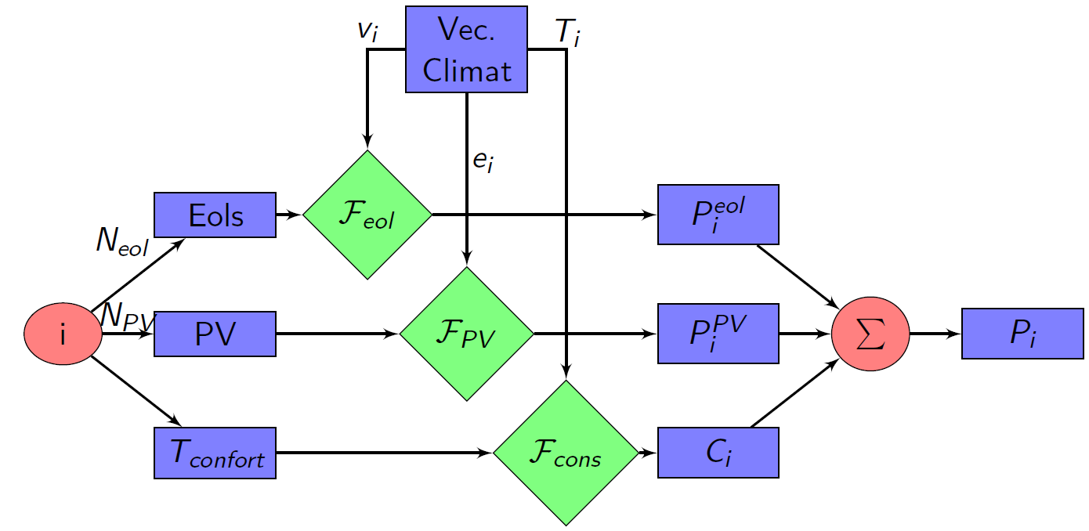

Coalition Formation Algorithm of Prosumers in a Smart Grid Environment
IEEE ICC 2015. Communications QoS, Reliability and Modeling Symposium. Session CQRM-I01
Authors
Abstract
Contract selection
Optimization
Nicolas Gensollen
Vincent Gauthier
Monique Becker
Michel Marot
In a smart grid environment, we study the coalition formation of prosumers that aim at entering the energy market. It is paramount for the grid operation that the energy producers are able to sustain the grid demand in terms of stability and a minimum production requirement. We design an algorithm that seeks to form coalitions that will meet both of these requirements: a minimum energy level for the coalitions and a steady production level, which leads to finding uncorrelated sources of energy to form a coalition. We propose an algorithm that uses graph tools such as correlation graphs or clique percolation to form coalitions that meet such complex constraints. We validate the algorithm against a random procedure and show that, it not only performs better in terms of social welfare for the power grid, but also that it is more robust against unforeseen production variations due to changing weather conditions for instance.
Coalitions estimate contracts for next periods
Gains are proportionals to the contracts
Penalities when not respected
Deviations are inavitable due to volatilities
Stable coalitions = less deviations = less risky payoffs
Correlations between agents impact stability of coalitions
Grid operator specifies
Maximum amount of risk acceptable :
Minimum production acceptable :
Maximizing mean production and minimizing volatility
Graph representation of the correlation structure
Uncorrelated cliques are selected as coalition seeds
Local greedy utility improvements of the seeds
Objectives
Prosumer = PROducer + conSUMER
Building a realistic prosumer model
Allowing virtual aggregations to sell energy
Restraining market to stable and productive coalitions
Maximizing the production on the market by optimizing the formation of the coalitions
Results
Comparison with :
Random search with stopping criterion (red curves)
Correlated coalitions (worst case, green curves)
We achieve :
Higher utilities
Higher contracts
Less volatility
Simulations
Conclusion
Prosumers are positionned geographically and configured (DER, Loads, preferences…)
Real weather data are used (wind speed, solar irradiance, temperature…)
The net productions are recorded for each agent :
The originality of this paper lies in its willingness to exploit the de-correlation of prosumer profiles in order to build stable coalitions. In this direction, we presented a model based on meteorological traces, that captures the complex climate vectors combination and generates realistic production and consumption patterns. We then built a framework that enables the grid to specify stability and minimum production requirements for filtering the coalitions. On this basis, we proposed a simple algorithm that seeks for uncorrelated prosumer patterns as potential seeds and expand them in coalitions able to rise above the grid requirements. We validated our algorithm against a random choice of coalitions, which can be considered as an average case. We showed that it performs better (coalitions are more stable and the overall production is more important) and that it exhibits a higher robustness/flexibility against grid requirements changes. The worst case scenario is represented by coalitions of correlated prosumers.
Differences between agents :
profiles (DER owned)
Weather (location)
Behaviors (consumption habits)
Nicolas.gensollen@﻿telecom-sudparis.eu
﻿http://complex.luxbulb.org/.

